Slide 1
Financial analysis
overview

Slide 2
Introduction:
The purpose of this financial analysis is to know about the past performance of our company.
To know how much profit our company has made in the past years.

Slide 3
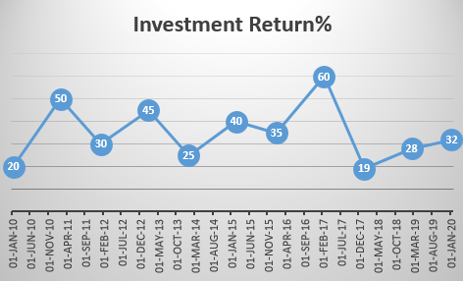

Slide 4
Financial metrics and investment stratergies:
Financial Metrics:
EPS: Profit per share of outstanding stock.
P/E Ratio: Compares stock price to EPS.
ROE: Profit in relation to shareholder equity.
D/E Ratio: Total debt to shareholder equity.
Investment Strategies:
Value Investing: Invests in undervalued companies.
Growth Investing: Invests in companies with high growth potential.
Dividend Investing: Invests in companies that pay regular dividends.
Index Investing: Invests in a diversified portfolio of stocks that track a market index.

